Slide 1
Summary of Housing Resources in Covid Response Bills and Pending Legislative Efforts

Slide 2
Presentation Agenda
CARES Act
FY 21 Omnibus Covid Relief Package
American Rescue Plan
Build Back Better Reconciliation Bill

Slide 3
CARES Act – Housing Provisions
Low Income Home Energy Assistance Program ($900M). Grants to states to support immediate home energy assistance for low-income households affected by coronavirus.
Community Development Block Grant ($5B). Provided in three tranches and used new allocation formula.
HUD Rental Assistance Programs
Section 8 Tenant-Based Rental Assistance ($1.25B). Funding to preserve Section 8 voucher rental assistance for seniors, the disabled, and low-income working families, who will experience loss of income from the coronavirus.
Section 8 Project-Based Rental Assistance ($1B). Additional funding to make up for reduced tenant payments and higher operating costs as a result of coronavirus.
Section 202 Supportive Housing for the Elderly ($50M). Maintain housing stability and services for low-income seniors given seniors are particularly at risk from the coronavirus.
Section 202 Supportive Housing for Persons with Disabilities ($15M). Funding to make up for reduced tenant payments and higher operational costs as a result of coronavirus.

Slide 4
CARES Act – Housing Provisions
Public Housing Operating Fund ($685M). Provide Public Housing Agencies with additional operating assistance to make up for reduced tenant rent payments, as well as to help contain the spread of coronavirus. To prevent, prepare for, and respond to coronavirus, including to provide additional funds for public housing agencies to maintain normal operations and take other necessary actions during the period that the program is impacted by coronavirus. Including activities to support or maintain the health and safety of assisted individuals and families, and activities to support education and child care for impacted families.

Slide 5
FY 21 Omnibus Covid Relief Package – Housing Provision
Emergency Rental Assistance ($25B) – first tranche
Emergency rental assistance funded through the Coronavirus Relief Fund formula. Of the total amount, $500 million is allocated to U.S. territories and $800 million to tribal communities. The remaining funds are distributed to states and cities with populations of 200,000 or more. Each state receives a minimum of $200 million.

Slide 6
American Rescue Plan – Housing Provisions
Background
On March 11, President Biden signed the American Rescue Plan Act of 2021
The bill provided $1.9 trillion in funding, program changes, and tax provisions to aid the nation’s response and recovery from the coronavirus pandemic
ARP included the most affordable housing and community development resources to date

Slide 7
American Rescue Plan – Housing Provisions
Homelessness ($5B)
Administered through HUD’s HOME Investment Partnership Program (HOME-ARP) and funding has been distributed to states and localities
Funding is targeted to high needs populations such as persons experiencing and at risk of homelessness and can be used for rental assistance, supportive services, and development subsidies. HUD just issued an implementing Notice.
Emergency Rental Assistance Program ($21.6B)
ARP provided an additional $21.6B, in addition to the original $25B appropriation
Funds must be used to provide financial assistance, including back and forward rent and utility payments, and other housing expenses, including supportive services
Funding has been allocated from both programs
Emergency Housing Choice Vouchers ($5B)
Targeted to same high needs populations as HOME-ARP funding & provides 70,000 longer term rental assistance vouchers.

Slide 8
American Rescue Plan – Housing Provisions
Homeowner Assistance Fund ($9.9B)
60 percent of each grant must be targeted to homeowners having incomes no greater than 100 percent of area median income
Funding can be utilized broadly for homeownership supports, including mortgage and utility assistance, housing counseling, property taxes, and other uses
States are required to submit a plan on how to use funding and many have received initial payments of 10% of their award amount. Treasury is reviewing plans.
Housing Counseling ($100M)
Of the funds provided, not less than 40% must be provided to housing counseling organizations that (1) target minority and low-income homeowners, renters, and individuals experiencing homelessness or (2) provide services in neighborhoods with high concentrations of minority and low-income homeowners, renters, and individuals experiencing homelessness.

Slide 9
American Rescue Plan – Housing Provisions
Fair Housing Initiatives Program ($20M)
Provides $20 million to support fair housing activities under the Fair Housing Initiatives Program. This will ensure fair housing organizations have additional resources to address fair housing inquiries, complaints, investigations, education and outreach activities, and costs of delivering or adapting services, during or relating to the coronavirus pandemic.
Low-Income Home Energy Assistance Program ($4.5B)
Additional appropriations for LIHEAP and money has not yet been released by HHS

Slide 10
American Rescue Plan – Housing Provisions
State/Local Fiscal Recovery Funds ($350B)
Establishes a new source of funding through a $350 billion allocation administered by Treasury for states, municipalities, counties, U.S. territories, and tribal governments
Distributed in two tranches, with 50% being delivered no later than 60 days from date of enactment, and the remainder delivered no later than one year later.
Funding can be utilized broadly, including for affordable housing development and assistance.
Treasury released a statement stressing recipients are not at risk of fund recoupment if they are using resources consistent with interim final rule. This is due to the numerous eligible uses and may help with uncertainty around allocating resources for housing purposes.

Slide 11
American Rescue Plan – Housing Provisions
State and Local Fiscal Aid Recovery Funds - Distribution
Funding Available to States and the District of Columbia: $195.3 Billion
$25.5 billion would be equally divided to provide each state a minimum of $500 million
$169 billion would be allocated based on the states’ share of unemployed workers from October to December 2020
States can transfer funds to private nonprofit groups
Funding Available to Counties: $65.1 billion
$65.1 billion in direct federal aid to counties based on the county share of the U.S. population
Counties that are Community Development Block Grant (CDBG) recipients will receive whichever is larger – the population-based share or the share under a modified CDBG allocation formula
Funding Available to Municipalities: $65.1 billion
With populations of at least 50,000: $45.57 billion in direct federal aid for municipalities using a modified CDBG formula
With populations below 50,000: $19.53 billion based on each jurisdiction’s percentage of the state’s population, not exceeding 75 percent of its most recent budget as of January 27, 2020.
Aid is distributed through the states

Slide 12
Build Back Better Reconciliation Bill – Housing Provisions
$3.5 trillion in FY 2022 Budget Reconciliation instructions to enact the Administration’s Build Back Better agenda
Senate budget resolution provides $332 billion for affordable housing and community development programs (along with transit) and presents a historic funding opportunity.
The House Financial Services Committee (HFSC) approved their portion of the $3.5T, and the next day the House Ways and Means Committee passed the tax portion of the bill.
This is a partisan bill and there are slim majorities in both the House and Senate.

Slide 13
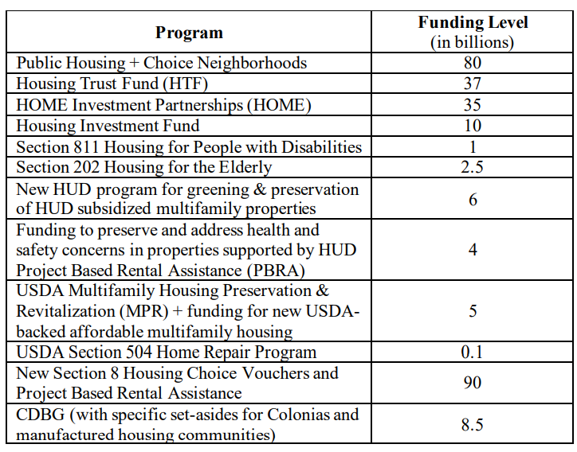
Build Back Better Reconciliation Bill – Housing Provisions

Slide 14
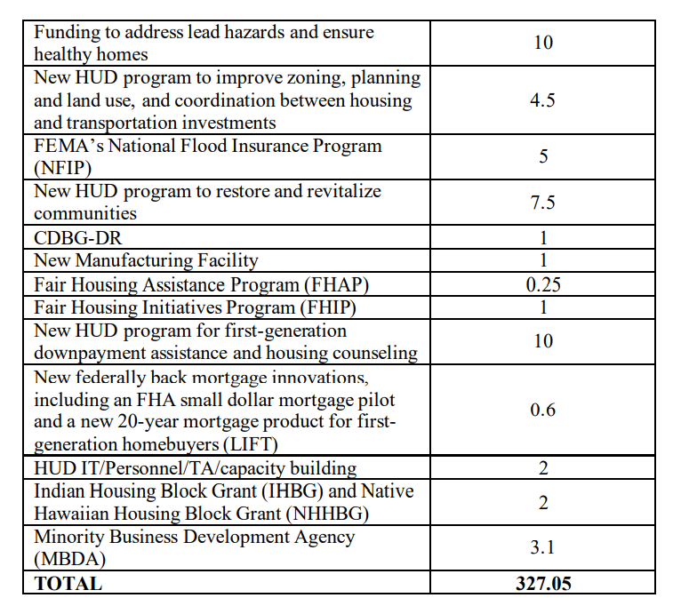
Build Back Better Reconciliation Bill – Housing Provisions

Slide 15
Build Back Better Reconciliation Bill – Housing Tax Provisions
Low-Income Housing Tax Credit
Largest increase in LIHTC program since it was started and modeled after Affordable Housing Credit Improvement Act
Increases Housing Credit allocation by 60%, with a four year phase in (2022-2025).
Lowers the 50% bond financing threshold to 25% for buildings placed in service after 12/31/21
Basis boost for ELI households, rural communities, Native areas, and other places identified by state agencies needing additional Housing Credits for financial feasibility
Reforms Qualified Contract loophole and strengthens Right of First Refusal

Slide 16
Build Back Better Reconciliation Bill – Housing Tax Provisions
Neighborhood Homes Tax Credit
Creates a federal tax credit (up to 35% of eligible development costs) that covers the gap between the cost of building or renovating homes and the price at which they can be sold, thus making renovation and new home construction possible
Homes must be owner-occupied for investors to receive credits
Income restrictions for eligible households and targeted to distressed communities
New Markets Tax Credits
Permanent authority and indexes allocation authority to inflation
Exception from the alternative minimum tax
Additional allocations to address economic impacts of the pandemic ($2B in FY 22 and $1B in FY 23)

