Slide 1
Eviction Moratorium Update
October 14th, 2021

Slide 2
Eviction Cliff: Background
The law:
The Eviction Moratorium played a critical role in keeping families safe in the pandemic.
A study by researchers at Duke found that eviction-prevention policies reduced the pandemic death rate by 11 percent
The Eviction Moratorium ended statewide in California on 9/30/21.
Some localities (like Alameda) have longer moratoria.
The state pre-empted localities from passing new, longer moratoria laws.
Renters still have protections after October 1st, and money is available for both rent and utility debt

Slide 3
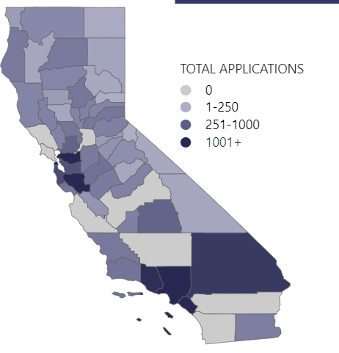
Eviction Cliff: Background
The Numbers:
Nearly 750,000 households behind on rent across the state, nearly ¾ of whom are People of Color
383,000 applications have been received for ERAP
While the state has received applications for about $3.8 billion in rental aid, it has distributed only about $720 million.

Slide 4
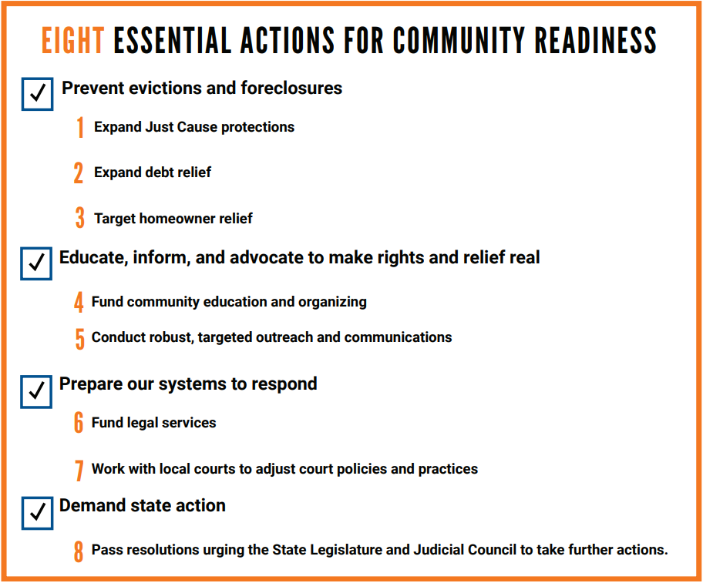
8 Essential Actions for the Bay Area

Slide 5
Understanding California’s Renter Protections

Slide 6
Spotlight:
Sam Tepperman-Gelfant, Public Advocates
Nathan Ho, City of San Jose
Alina Harway, Nonprofit Housing

