Slide 1
2021 Legislative Session Overview
By NPH Policy Manager,
Beilul Naizghi

Slide 2
2021 Legislative Session was unusual…
Caps on the number of bills legislators could introduce
Ongoing COVID issues
Ongoing discussions with the building trades, and
The recall effort of Governor Newsom on the ballot
NPH Non-Profit Housing Association of Northern California

Slide 3
By The Numbers
2,776 bills introduced this year
836 bills passed by the Legislature
770 signed by Governor Newsom
30 Housing Bills
NPH Non-Profit Housing Association of Northern California

Slide 4
Land Use and Zoning Bills
SB 9 (Atkins) will streamline the process for a homeowner to create a duplex or subdivide an existing lot in all residential areas.
SB 10 (Wiener) creates a voluntary process for local governments to access a streamlined zoning process for new multi-unit housing near transit or in urban infill areas, with up to 10 units per parcel.
SB 478 (Wiener) housing development projects. This bill prohibits a local government from imposing certain floor area ratio (FAR) standards on housing projects of 3-10 units.
NPH Non-Profit Housing Association of Northern California

Slide 5
Fair Housing and Equity
AB 1466 (McCarty) requires county recorder offices to redact any unlawfully discriminatory restrictive covenants in that county’s property records and authorizes the imposition of a fee to fund the program.
AB 1584 (Chiu) will give descendants of people previously displaced by San Francisco urban renewal and other redevelopment projects priority in state affordable housing programs. “As residents displaced by redevelopment have gotten older, it makes sense to extend this program to their children and grandchildren so a new generation has the opportunity to afford to live in San Francisco,” said Assemblyman Chiu.
AB 491 (Ward) Requires that, for mixed income multifamily structures, the occupants of the affordable housing units within the mixed-income multifamily structure shall have the same access to the common entrances, areas and amenities as the occupants of the market-rate housing units.
NPH Non-Profit Housing Association of Northern California

Slide 6
HCD
SB 791 (Cortese) This bill creates the Surplus Land Unit within the state Department of Housing and Community Development (HCD), to facilitate the development and construction of housing on local surplus property.
AB 787 (Gabriel) Authorizes cities and counties to receive credit towards their regional housing need for the conversion of above moderate-income units to moderate-income units.
AB 215 (Chiu) Provides the Department of Housing and Community Development (HCD) with additional enforcement authority for local agency violations of specified housing laws, and increases public review for housing elements.
AB 602 (Grayson) Adds new requirements to impact fee nexus studies. Requires cities and counties to request certain information from development proponents and requires the Department of Housing and Community Development (HCD) to develop a nexus study template.

Slide 7
Other Housing Bills
AB 816 (Chiu) Requires HCD to allocate National Housing Trust Fund (NHTF) monies to projects serving individuals experiencing homelessness, to the extent that a sufficient number of projects exist. And authorizes HCD to alter priority for funding in order to align eligibility for benefits, such as Medi-Cal, that are intended to fund services for individuals experiencing homelessness.
SB 591 (Becker) will allow affordable housing developers to build intergenerational housing serving seniors and transition age youth. Co-sponsored by NPH member EAH Housing, and the City of Emeryville.
SB 8 (Skinner), which extends the provisions of the Housing Crisis Act of 2019 through 2030. The Housing Crisis Act of 2019, which was scheduled to expire in 2025, accelerates the approval process for housing projects, curtails local governments’ ability to downzone and limits fee increases on housing applications, and more.

Slide 8
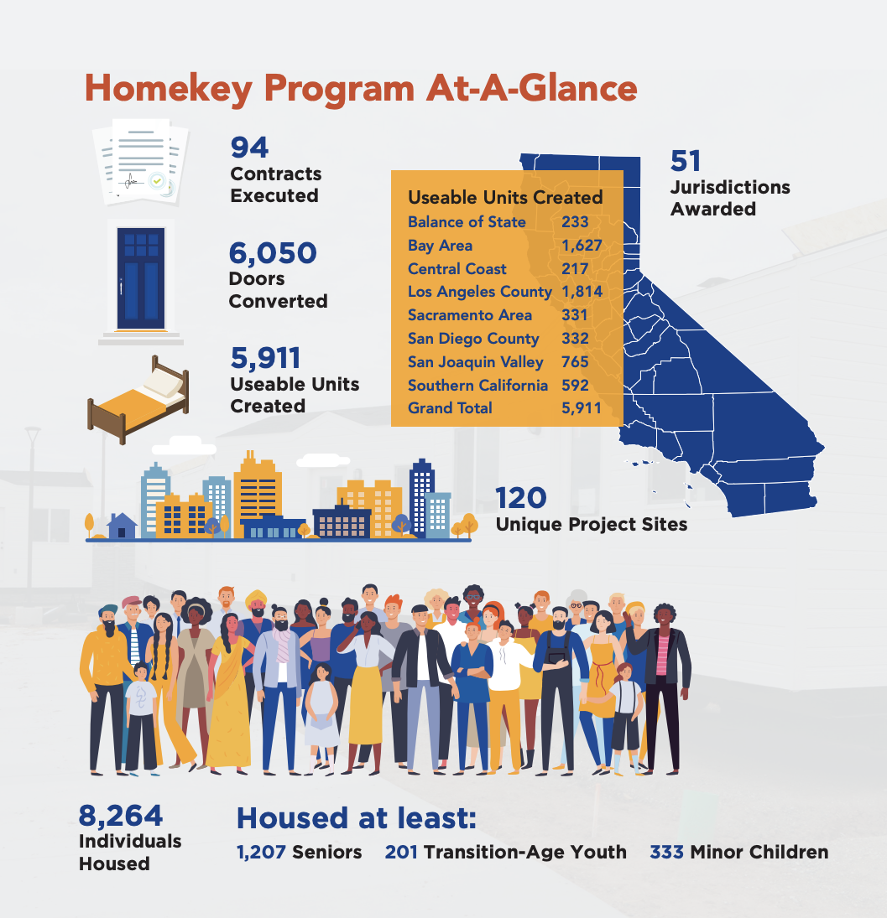
Project Homekey - $2.75 billion
Source: HCD Homekey Legislative Report

Slide 9
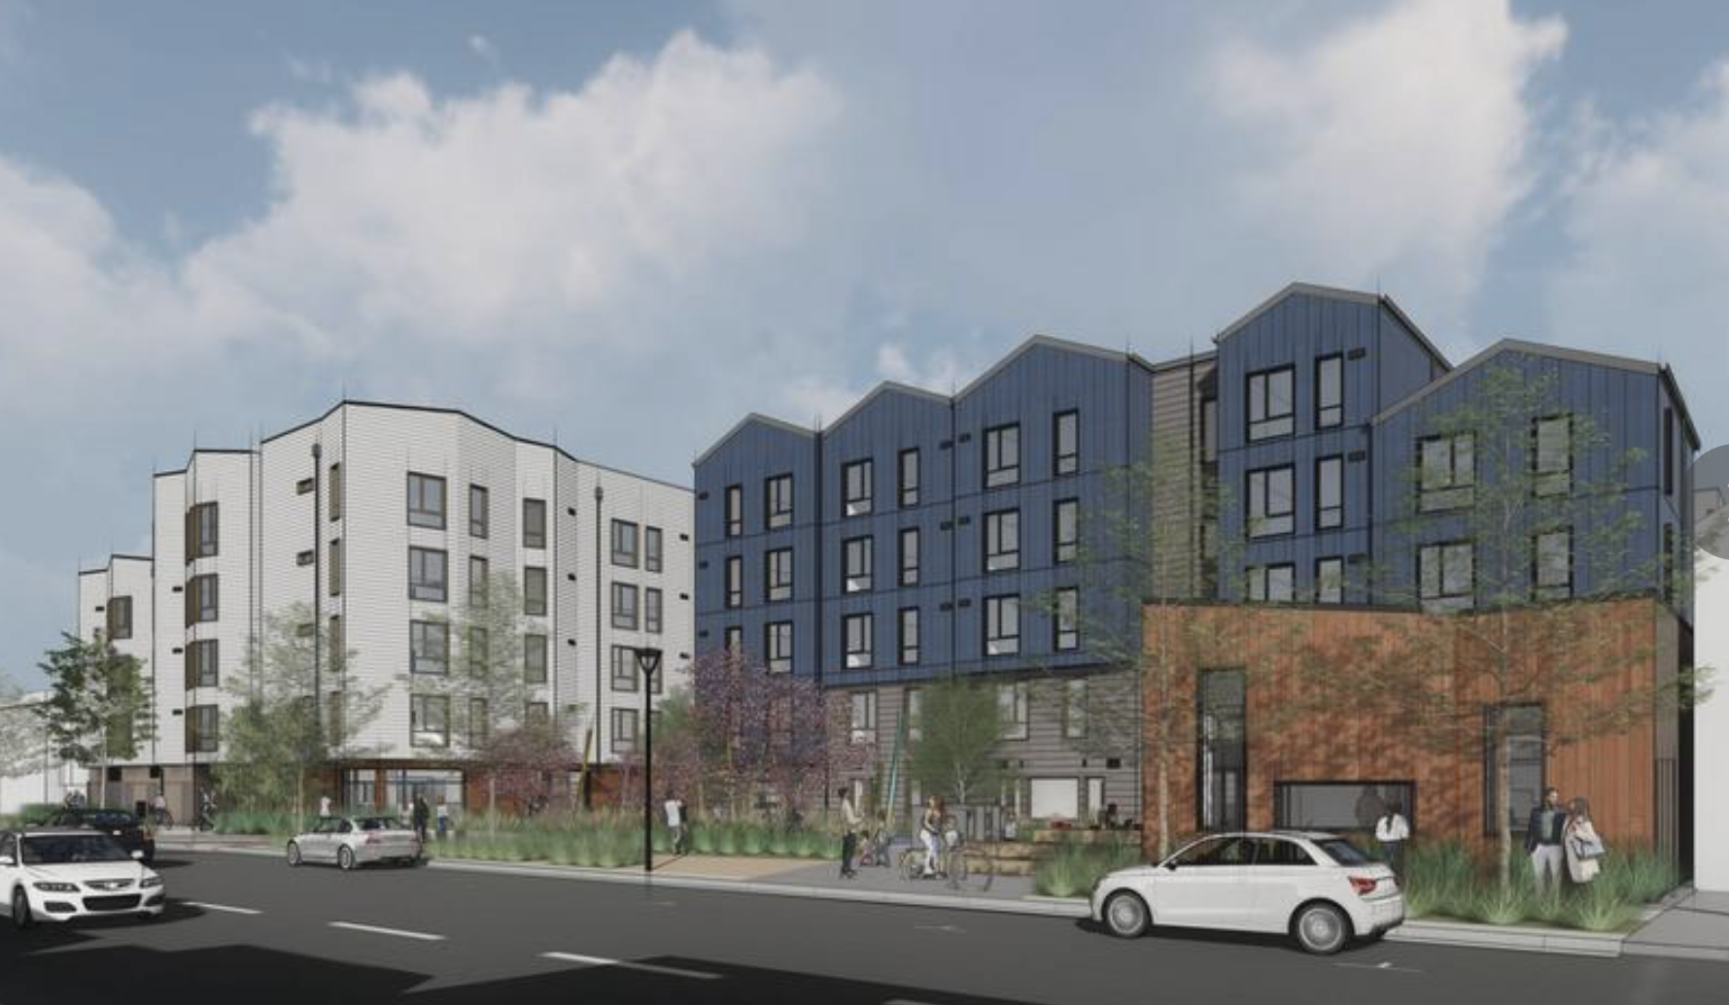
California Housing Accelerator - $1.75 billion
The California Housing Accelerator is a part of the California Comeback Plan and will expedite construction of about 6,500 shovel-ready affordable multi-family units in projects stalled due to constraints on the supply of tax-exempt bonds and low-income housing tax credits.
Shirley Chisholm Village is an innovative development on San Francisco Unified School District-owned land that has been ready to start construction for 12 months! The project is waiting for a bond allocation to begin.
135 homes for teachers, para-educators and their families
NPH Non-Profit Housing Association of Northern California

Slide 10
Thank you!
Beilul Naizghi
beilul@nonprofithousing.org
@NPHANC

