Slide 1
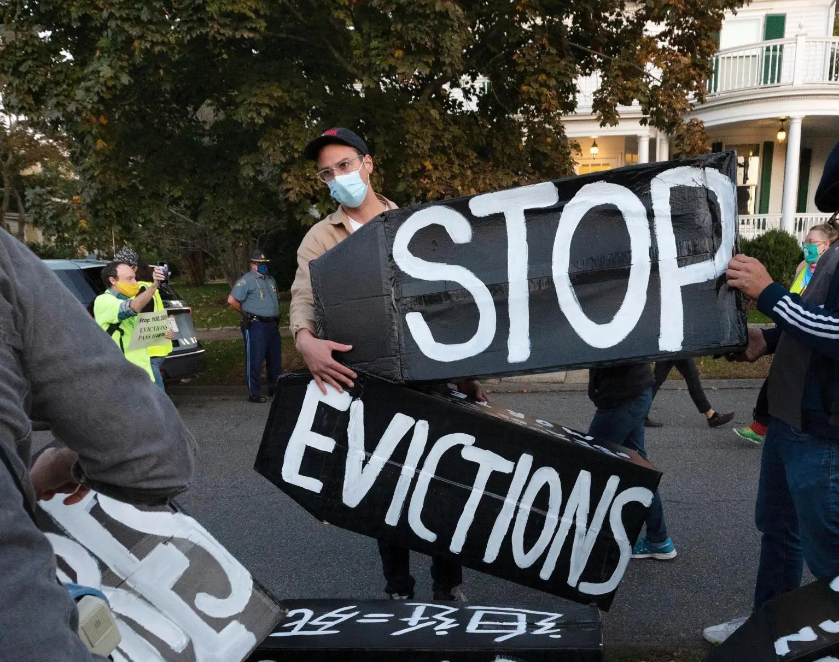
Emergency Rental Assistance Update
March 31, 2022

Slide 2
County-wide Data as of 3/28/22
13,801
$305,000,000 Requested
5,584
$81,101,488 Approved
1,928
$41,207,031* in Final or Compliance Review
*auto-calculated, amount may be lower

Slide 3
Approved Disbursements by Month
$2.7M
$682k

Slide 4
Reallocated Funds
Two reallocation rounds so far
first round intrastate
Fremont successful in second round
Third round anticipated April/May
State offering forgivable loan to fill gap
Notes:
City of Chula Vista - $1,045,895.28
City of Fremont - $370,426.66
City of Long Beach - $965,616.37 City of Moreno Valley - $444,511.99
City of Sacramento - $1,749,894.63 City of San Diego - $7,133,772
City of Stockton - $688,773.18
Monterey County - $959,195.51 San Diego County - $8,116,619.80
Santa Barbara County - $1,045,455.46
State of California - $136,442,352.56
Prioritize states and local governments that have been successful at getting assistance to those in need
Prioritize jurisdictions with high levels of need as measured by the number of low-income rents and people experiencing homelessness who are disproportionately people of color.
Maintaining renters access to ERA funding across all jurisdictions

Slide 5
Distribution – income of tenants
Over 70% of funds have gone to tenants with an extremely low income
We continue to see that our applications mirror our priority of serving those most in need

Slide 6
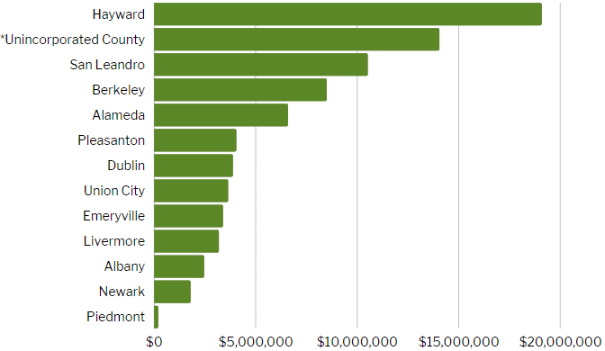
Distribution – Where are the funds going?
*includes Ashland, Cherryland, Castro Valley, San Lorenzo, Sunol, and Tracy

Slide 7
Black, Indigenous or People of Color
66% County-wide

Slide 8
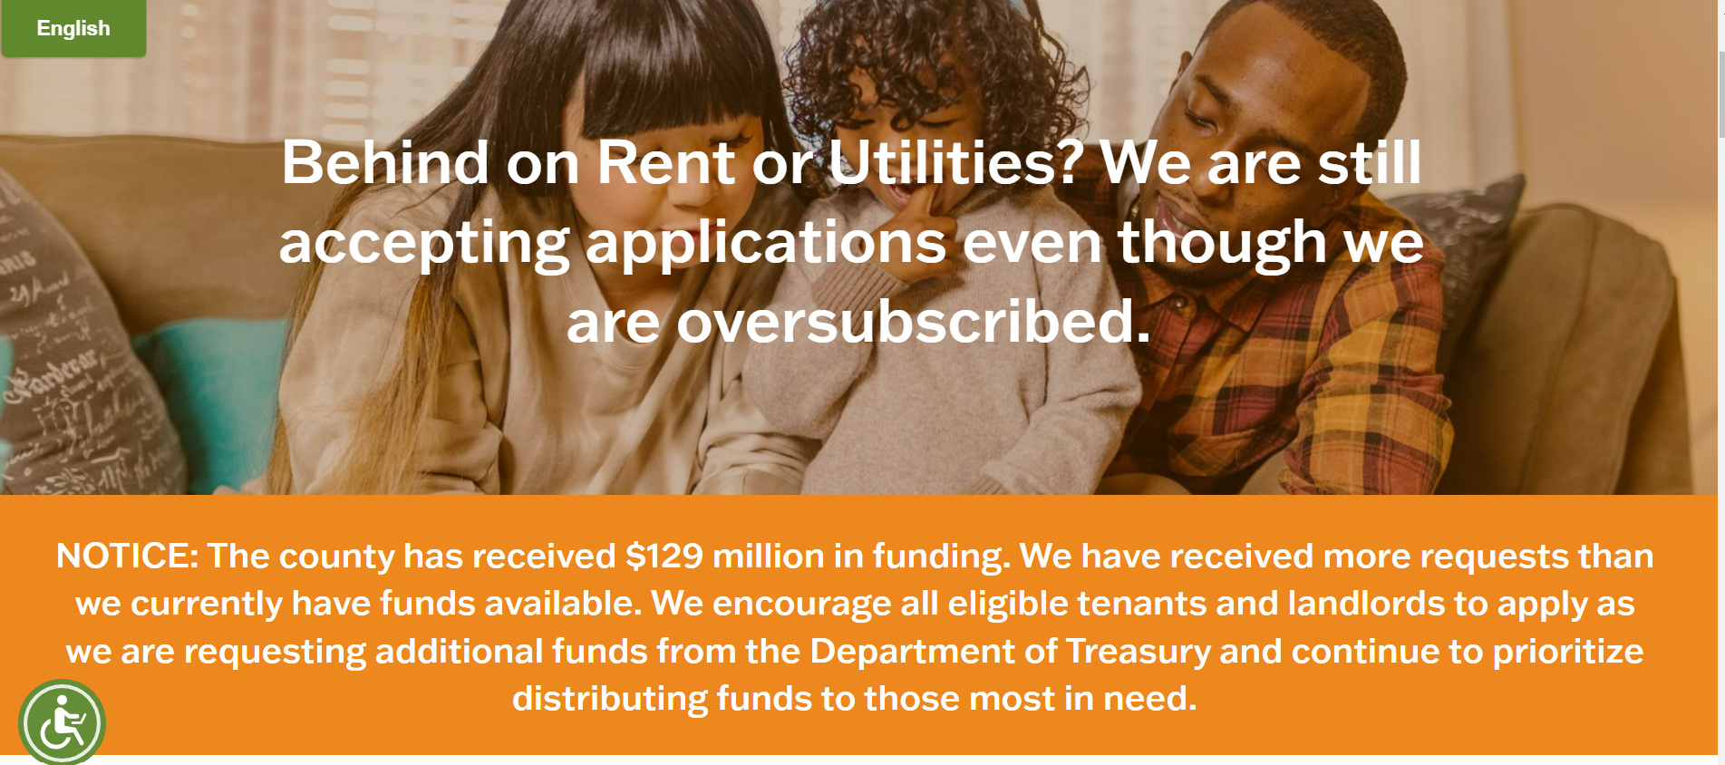
The AC Housing Secure Portal Remains Open
AB 2179 vote expected today
Extends eviction protections through 6/30/22
Preempts jurisdictions from modifying local moratoria until 7/1/22
Requires tenants to have pending application by 3/31 to be protected under the State moratorium
Alameda County portal remains open and eviction moratorium remains in effect until 60 days after the public health emergency is over

Slide 9
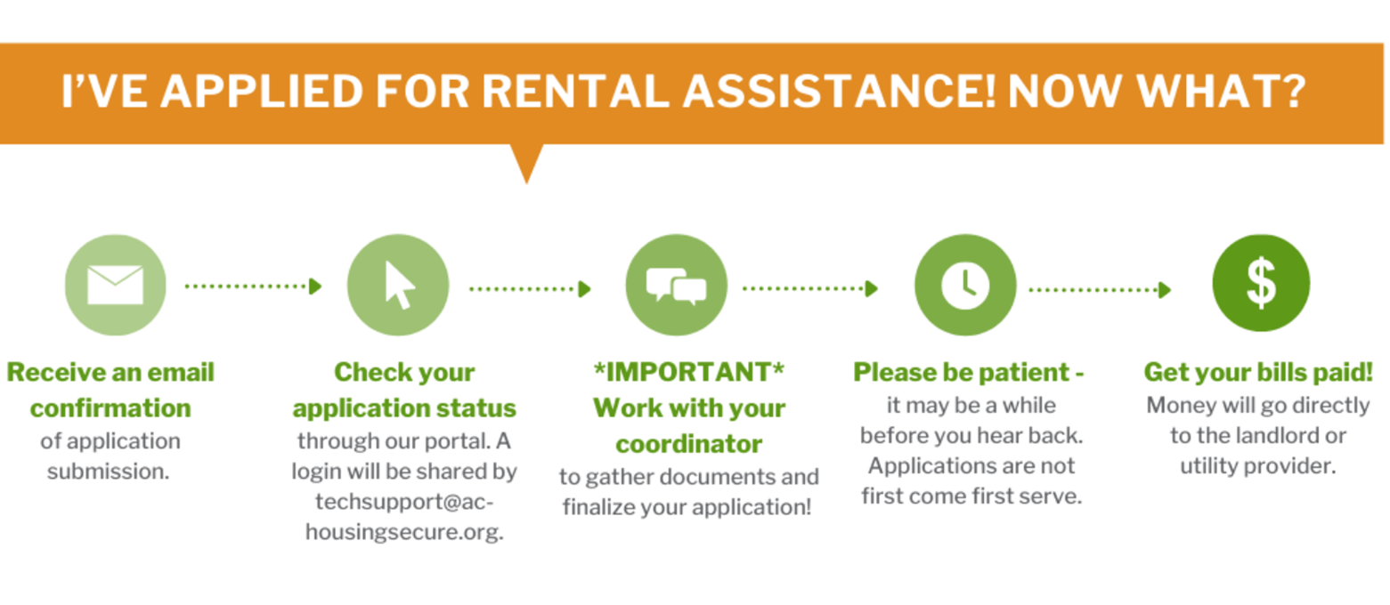
Application Process
Apply online
Application is assessed and scored based on criteria
Applications are rated 1-15
High-scoring applications move to the top – regardless of when submitted
The higher the score, the higher the risk of homelessness
Prioritized applications are sent to Application Coordinators
Coordinators reach out to applicants to review and complete applications
Coordinators reach out via phone, text, email and letter. If no response, the application is returned to the in-box
Tenants must respond to their application coordinators – if they don't respond, their application will not be completed and their landlord will not be paid.

Slide 10
Tenants Want to Pay their Rent
86% of all applications in AC Housing Secure are tenant-initiated
2,500 landlords have not responded to multiple AC Housing Secure outreach attempts

Slide 11
Landlords Need to Get Paid
14% landlord-initiated Applications
1,000 tenants have not responded to AC Housing Secure

Slide 12
Steps Taken to Increase Tenant Participation
Sending multiple emails to addresses provided by the landlord
Sending notices via US Mail to reach the tenant
Utilizing the County’s 211 network to conduct text outreach
17% applied after receiving letter and/or email
18% applied by end of text campaign

Slide 13
Why tenants are nonresponsive
A lack of understanding about the opportunity for rental assistance
Concern over immigration status
A less-than-cordial relationship with the property owner
A risk to rent forgiveness or rental reductions negotiated privately
A fear of loss of public benefits

Slide 14
Steps Taken to Increase Landlord Participation
East Bay Rental Housing Association (EBRHA) and the Rental Housing Association of Southern Alameda County (RHA) are both engaged as application assistants.
Contact info for the 2,500 property owners has been provided by AC Housing Secure
EBRHA and RHA have hosted outreach sessions specifically for small landlords
County must cut a check to the tenant if the landlord does not participate.

Slide 15
35% of all ERAP applicants
have been threatened with
eviction by their landlords during the pandemic and the eviction moratorium

Slide 16
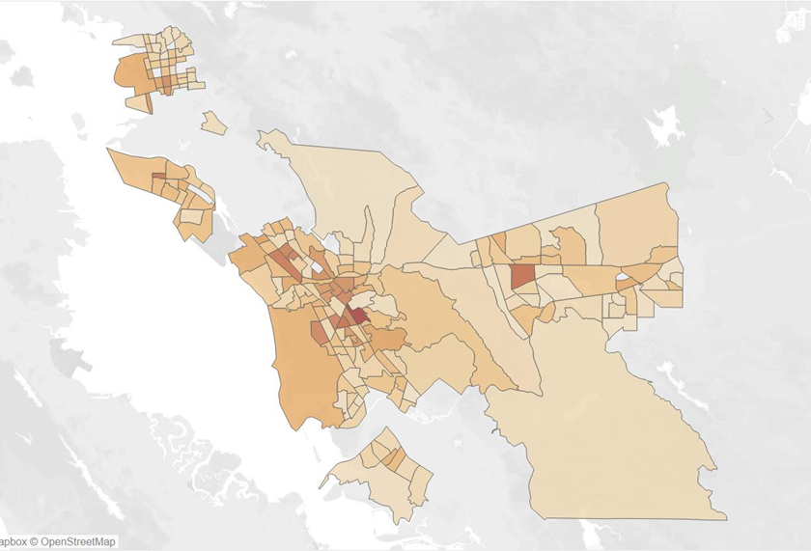
Who will be Impacted by Evictions?
Tenants whose Landlords have threatened to evict during the pandemic
76.4% of tenants facing eviction are BIPOC, while the county overall is 50.7% BIPOC.
Tenants facing eviction are more than twice (2.3) as likely to be Black and 1.4 times as likely to be Latinx than the general county population.
These statistics further demonstrate that the Pandemic has had a disproportionate impact on BIPOC communities
This map reflects data collected through ERAP and by ACHS legal service providers through November 17, 2021. It does not include tenants who have not accessed ERAP or AC Housing Secure Legal Services, nor does it include data from Oakland or Fremont, and is therefore an under count.

Slide 17
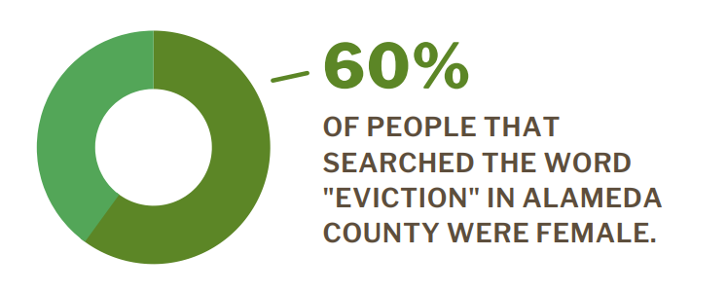
Info from 30-day Google Ad Campaign
Protecting those who are most vulnerable is the ERAP goal

Slide 18
End of Program – Landlords and Homeowners
Landlords and Homeowner
California Mortgage Relief Program
Emergency Mortgage Assistance (EMAP)
HERA
Small Claims

Slide 19
End of Program – Tenants
Alameda County Housing Secure

Slide 20
Questions

