Slide 1
Regional Housing Needs Allocation (RHNA) & Housing Element Update
Justine Marcus, Enterprise Community Partners
March 31, 2022
Notes:
10:25am

Slide 2
2023-2031 RHNA Allocations, by County
Unprecedented housing goals across the region
County | Very Low- & Low-Income Homes | Moderate & Above Moderate Homes | Total Homes
Alameda | 37,197 | 51,800 | 88,997
Contra Costa | 21,031 | 28,012 | 49,043
Marin | 6,571 | 7,834 | 14,405
Napa | 1,796 | 2,048 | 3,844
San Francisco | 32,881 | 49,188 | 82,069
San Mateo | 19,219 | 28,468 | 47,687
Santa Clara | 50,923 | 78,654 | 129,577
Solano | 4,415 | 6,577 | 10,992
Sonoma | 6,301 | 8,261 | 14,562
Total | 180,334 | 260,842 | 441,176

Slide 3
RHNA Comparison, 2015-2013 verses 2023-2031
Unprecedented Housing goals across the region
+135%
+120%
+102%
+184%
+138%
+190%
+527%
+159%
+58%
+72%
+ Percent Increase between RHNA Cycles

Slide 4
Local Jurisdiction Appeals
Unprecedented Housing goals across the region
28 appeals were submitted by 27 jurisdictions (1 jurisdiction submitted 2 appeals)
23 of the 27 jurisdictions that submitted appeals were considered “racially and economically exclusionary” via ABAG’s original metrics
Appeals primarily cited local infrastructure constraints, fire hazards, access to jobs, developable land, previous RHNA performance (not permissible), and general disapproval of the methodology
All appeals were denied except 1 appeal submitted by Contra Costa County, which was partially approved to account for an error in not reflecting a recent annexation by Pittsburg of land formerly in unincorporated Contra Costa County (412 homes adjusted)

Slide 5
IT TOOK A REGION!
Notes:
January 12th, 2022 HCD approved the RHNA methedology

Slide 6
Housing Element Update Timeline
Key deadlines approaching
ABAG is recommending posting initial draft for public comment by April
January 2023
Housing Elements Adopted by City or County & Submitted to HCD
Local jurisdictions must post draft HE for public comment for 30 days + 10 days to incorporate before submitting to HCD
HCD has 90 days to review (first submission)
If local jurisdiction submits subsequent drafts, they must post new draft HE for public comment for 7 days
HCD has 60 days to review (subsequent submissions)
HCD certification of HE by May 31, 2023 (120 days after submission)

Slide 7
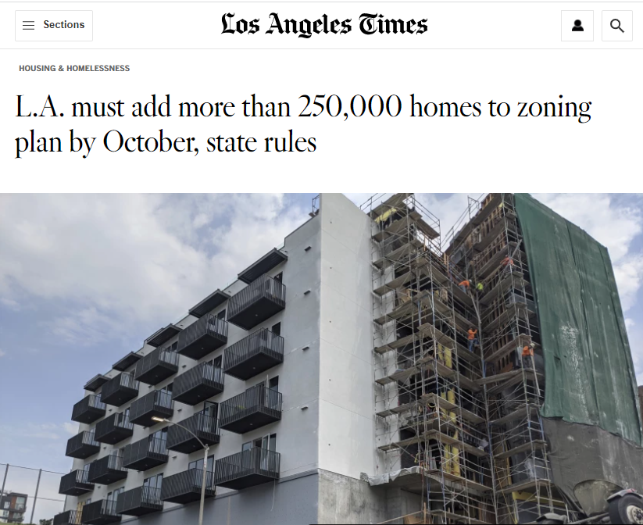
What happens after January 2023?
Jurisdictions have 3 years to complete their rezoning
EXCEPT, if housing elements are NOT in compliance within 120 days of due date, then all rezoning must be completed in 1 year
AND, if rezoning is adopted after its due date, all residential rezoning for at least 20% affordable projects must be “by-right”
Many more impacts of being out of compliance – see ABAG memo on the subject!

Slide 8
Advocacy and Resources
Bay Area Housing Element Working Group, convened by Public Advocates
Toolkits aimed at helping community members leverage Housing Element requirements (including AFFH) to advance local campaigns and priorities: http://housingelementtools.org/ (e.g., rent control, IZ policies, site selection)
Climate and Housing Working Group
County-specific working groups convened by local partners
NPH Community Engagement Resources: messaging guide, video content, trainings, and other resources to support advocates and encourage residents to make their voices heard
ABAG/MTC Regional Housing Technical Assistance Program (RHTA)
Notes:
Bay Area Housing Element working group (community organizers, housing lawyers, CLTs, and affordable housing policy organizations) collaborating to ensure that all cities and counties in the region adopt Housing Elements that respond to pressing needs of low-income residents
housingelementtools.org [housingelementtools.org] explains why community members should get involved in the Housing Element process and provides toolkits
Toolkits aimed at helping community members leverage Housing Element requirements (including AFFH) to advance their existing campaigns and priorities
Toolkits provide legal, policy, and data arguments and resources coupled with strategic messaging guidance and talking points
Some are focused on winning enforceable commitments from local governments to pass policies like rent control [publicadvocates.org] and inclusionary zoning [publicadvocates.org]
Others provide tools for Housing Element advocacy on expanding resources for community land trusts [cacltnetwork.org] and ensuring the jurisdiction selects suitable sites for housing [publicadvocates.org]
The message guide will likely be available in mid April and the trainings will be from April to May.

Slide 9
Connecting the Regional Dots
REGIONAL RESOURCES, POLICY, AND REACHING OUR GOALS
2023
Housing Element Update
Rezoning & Housing Element Implementation
2031 RHNA Goals
PBA 2050 Goals

Slide 10
Connecting the Regional Dots
REGIONAL RESOURCES, POLICY, AND REACHING OUR GOALS
2024 BAHFA
GO Bond for $10B
IMPLEMENTATION RESOURCES
BAHFA Pilot Programs
$102M REAP 2.0
REAP 1.0 Technical Assistance
2022-2026
PDA Planning Grants
2023
Housing Element Update
Rezoning & Housing Element Implementation
2031 RHNA Goals
PBA 2050 Goals

Slide 11
Connecting the Regional Dots
REGIONAL RESOURCES, POLICY, AND REACHING OUR GOALS
2024 BAHFA
GO Bond for $10B
IMPLEMENTATION RESOURCES
BAHFA Pilot Programs
$102M REAP 2.0
REAP 1.0 Technical Assistance
2022-2026
PDA Planning Grants
2023
Housing Element Update
Rezoning & Housing Element Implementation
2031 RHNA Goals
PBA 2050 Goals
Summer 2022
MTC’s Transit-Oriented Communities Policy
INCENTIVES
OBAG 3
OBAG 4
2023-2026
2027-2030

