Slide 1
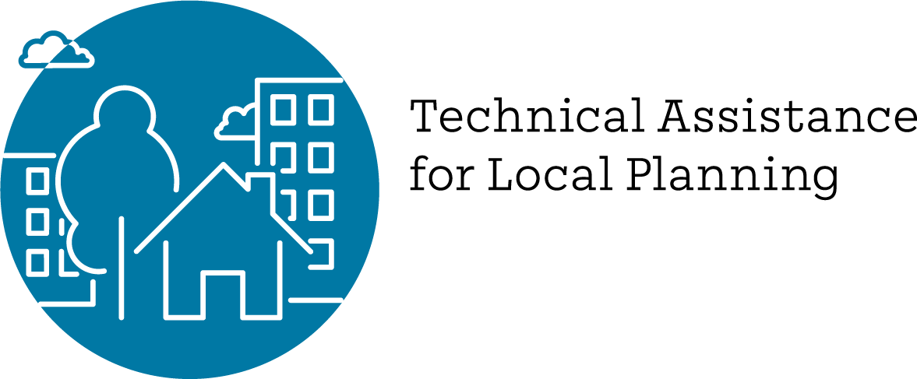
MTC/ABAG’s Regional Housing Technical Assistance (RHTA) Program
Partnership For the Bay’s Future
Policy Working Group
Daniel Saver
March 31, 2022

Slide 2
Regional Housing Technical Assistance Program (RHTA)
Launched by ABAG in 2020 with support through December 31, 2023 from a $24 million State Regional Early Action Planning (REAP) Grant
Supplements nearly $50 million in direct funding from state to local governments for housing planning via LEAP & SB 2 grants
RHTA Focus in 2020-2022: support local jurisdictions to adopt compliant Housing Elements to implement 6th Cycle of RHNA
RHTA Focus in 2023 and Beyond: Support local jurisdictions to implement their housing elements and regional housing priorities (Plan Bay Area 2050, Transit Oriented Communities Policy, etc.)

Slide 3
New State Enforcement
HCD's Housing Accountability Unit
"A housing element is no longer a paper exercise – it's a contract with the state of housing commitments for eight years, and the HAU will hold jurisdictions to those commitments." HCD Press Release October 2021
Attorney General's Housing "Strike Force"
"This is, I believe, something unique in the history of the California Department of Justice to have the priority and emphasis and focus on housing, law enforcement, that we have.” Attorney General Rob Bonta November 2021
Link to memo on consequences of non-compliance

Slide 4
RHTA Delivery Model
Regional Assistance - $13M
Local Allocations - $11M
Deliver programs that have a broader regional impact on housing
Support local planners with technical assistance & housing expertise
Support local elected officials with information & messaging
Reduce local costs & administrative burden
Direct financial allocations to all 109 local jurisdictions
Fund County Planning Collaboratives
Allow local access to Regional Consulting Bench or funding for local consultants

Slide 5
Housing Element assistance available at all levels
Regional
County
Local
Trainings and products covering most common topics
Shared consultant for county-based Planning Collaboratives, tailored assistance
Local data, translation services, and direct funding for local planning priorities

Slide 6
Available Housing Element Technical Assistance
Regional
20 recorded webinars & trainings
New laws implementation support
Guidance on Affirmatively Furthering Fair Housing (AFFH)
Counting ADU's towards RHNA
Parking Handbook
Resilience planning resources
How to talk about housing
Templates for reports, presentations and more
County & Local
Planning Collaboratives
Customized data packets
Online Housing Element Site Selection Tool (HESS)
Translation services
VMT-reduction Planning Cohorts
Software pilots for online engagement and permitting streamlining
"Big 3" Cities Cohort
Workgroups
Wildfire Planning
Missing Middle Housing
Leading with Equity
See summary handouts of TA resources in PBF’s web portal or ABAG website!

Slide 7
RHTA: Beyond Housing Elements
RHTA
Housing Policy & Program Implementation –
Including Rezoning and SB9
Plan Bay Area 2050 Implementation – e.g., Transformation of Malls, Office Parks and Public Lands
Transit Oriented Communities (TOC) Policy Support and Implementation

Slide 8
Thank You.
Daniel Saver
Assistant Director, Housing & Local Planning
dsaver@bayareametro.gov

